Slide 1
Improving the cancer journey in powys
Theory of Change
December 2021

Slide 2
Table of Contents
page
page
page
page
4
6
8
12
Introduction
Improving the Cancer Journey in Powys
Developing a Theory of Change for ICJ Powys
Key Principles
page
page
page
13
16
19
From Actions to Outcomes
Theory of Change Visual
Thanks and Acknowledgements

Slide 3
Notes on terminology
People Living with Cancer
When we refer to ‘People Living with Cancer’, we mean people with a cancer diagnosis, their unpaid carers, their families and those important to them. We also include people who have been referred with a possible cancer diagnosis and are awaiting the results of that referral.
Very occasionally, to save space in the Theory of Change visual we abbreviate to the acronym PLWC.
Team ICJ
ICJ in Powys is a partnership, and seeks to create a truly integrated model of support across statutory and voluntary sectors. When we refer to ‘Team ICJ’ we are referring to all the partner organisations, staff, volunteers who are part of designing, managing and delivering ICJ in Powys.
Link Worker
Rather than a specific job title, when we use the term ‘Link Worker’ we are referring to a practitioner who offers personalised supportive conversations to people living with cancer.
Link Workers are based in the organisations delivering the pilots, and may have a variety of job titles and professional backgrounds.
Personalised Support
When we use this term, we mean the full range of non-medical support that people living with cancer might need to maximise their quality of life. Support may be cancer-specific in some cases, but often will not be. It will include emotional, psychological and practical support, social care, financial and welfare advice and support to access Council services such as housing, transport and travel, leisure and education.

Slide 4
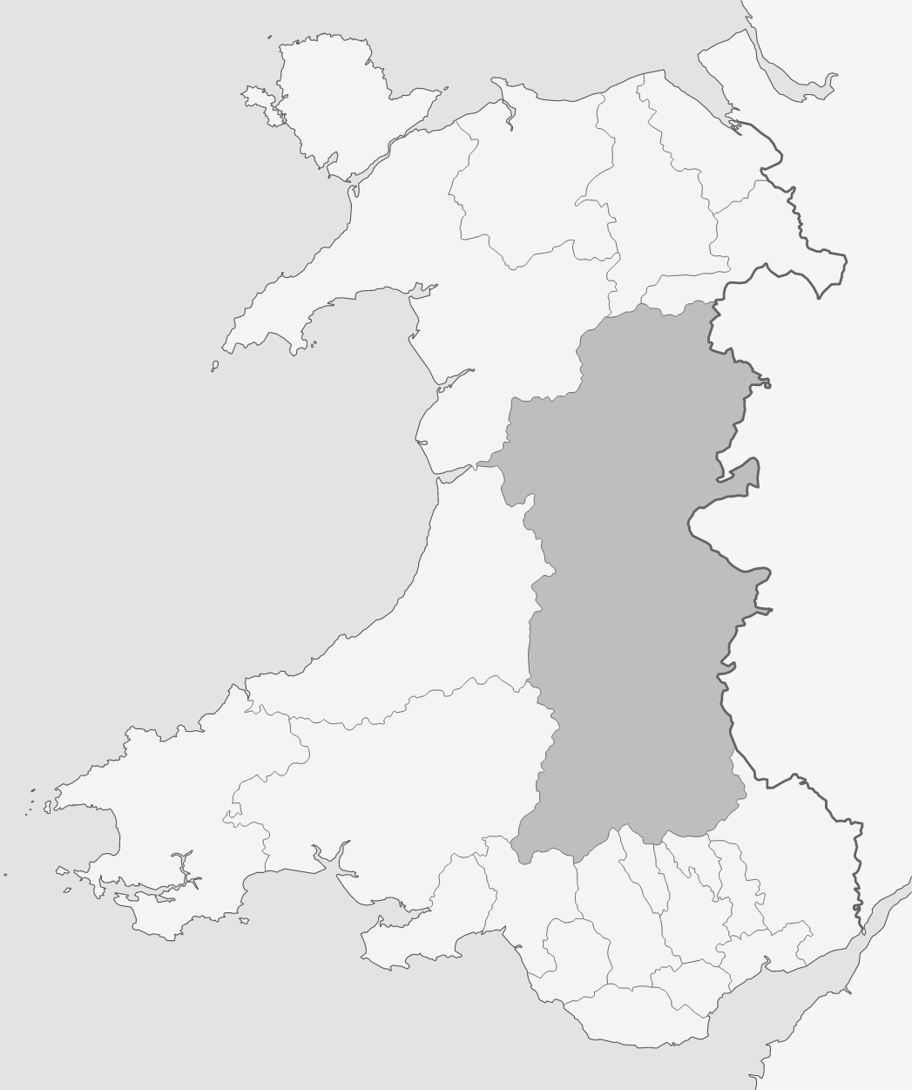
Introduction
Powys is a large rural county in Wales, with a population of just over 133,000 people spread across an area of around 2,000 square miles.
Powys Teaching Health Board provides health services in the county, and aims to maximise local provision through GPs, primary care, community hospitals and community services. There is no District General Hospital in Powys. Local residents receive the majority of their cancer diagnostics, assessment, treatment and care in a variety of NHS centres across Wales and over the border into England, depending on where they live and their tumour site. Consequently, they often have long journeys for their treatment and follow up reviews. The variety of treatment centres, operating within two different national health systems, makes for variable patient experience over which Powys Teaching Health Board currently has limited influence. There are also challenges with access to accurate patient data across such a fragmented system, which impacts on the ability to understand the cancer population in Powys and plan accordingly.
Powys County Council is the local authority for the county, providing a wide range of services to the people of Powys. These include social care, housing, roads, transport, digital connectivity, education, leisure, libraries. Powys County Council benefits from having an established benefits team in partnership with Macmillan, providing a holistic approach to financial support for people diagnosed with Cancer. Provision of these essential services across such a large and rural geographical area, creates access challenges for people living outside of the main population centres.

Slide 5
Powys and its unique context
Powys’ geography creates some unique challenges for planning and delivering services
Absence of District General Hospital and reliance on Health Trusts and Boards outside the county, which means people always have to travel for specialist treatment
Rural geography is combined with high levels of rural poverty
Population density is low across much of the county; many people live far from a town, and the towns themselves are relatively small with limited services
Digital connectivity is very poor outside the main towns, which prevents use of online tools and delivery models
Digital poverty ¹ prevents many people from using online services even where connectivity permits
High percentage of people who’s first language is Welsh, and challenges in providing services in Welsh
However, Powys has a number of assets that can support local service innovation
A vibrant voluntary sector committed to supporting local people
3422 unpaid carers providing care and support to local people
A strong partnership between the Health Board and County Council that pre-dates the recently introduced Regional Partnership Board
A genuine commitment to improving the cancer journey for local people, with strong relationships across the three strategic partner organisations and a small number of key partners in the voluntary sector
Recent appointment of a Cancer Tracker role for Powys
Local commitment to digital transformation in the Powys Health and Care Strategy ² ,to increase connectivity and reduce digital poverty
Established Welfare Benefits team
1. https://www.wcpp.org.uk/commentary/rural-poverty-the-case-of-powys/
2. Our Strategy - Powys Teaching Health Board (nhs.wales)

Slide 6
Improving the Cancer Journey in Powys
In 2016, Powys Teaching Health Board, Powys County Council and Macmillan Cancer Support formed a strategic partnership to explore ways of improving services for people living with cancer in the county.
This centred on providing personalised holistic support for people living with cancer, to help meet their wider non-medical needs, which an increasing evidence base shows have an influence on an individual’s cancer journey and their quality of life. This led to the development of the ‘Improving Cancer Journey in Powys’ programme (ICJ), inspired by the principles of the Macmillan ICJ programme that originated in Glasgow and is now being adopted in various other parts of the UK.
National and local policy aims to provide equitable access to holistic, seamlessly co-ordinated care and support, with a focus on wellbeing as well as physical health. However, conversations about needs and support commonly take place in settings close to treatment centres, which are often not easily accessible for Powys residents.
It is unlikely that the location of cancer treatment centres will change in the foreseeable future; Powys has too small a population to support localised specialist cancer services. However, it is possible to improve local access to person-centred non-medical support, so that people living with cancer in Powys can receive support to address their worries, concerns and needs closer to home.
This is the focus of Improving the Cancer Journey in Powys: to develop a sustainable, supportive, integrated community model of care to support people living with cancer in Powys.

Slide 7
What ICJ in Powys will do
ICJ in Powys aims to ensure that every Powys resident* with a cancer diagnosis is offered a personalised supportive conversation, which explores their holistic needs and results in a care plan and access to appropriate support as close to home as possible.
The programme has involved people affected by cancer and those supporting people with cancer, to:
Develop a deeper understanding of issues and experiences of local people living with cancer
Review how and where people living with cancer in Powys currently receive treatment and personalised support
Based on this evidence, develop a number of pilot approaches to providing personalised support conversations, to be trialled and evaluated
Once the pilot approaches have been evaluated, the intention is to develop a business case for extending provision of the successful approach(es) for all Powys residents with a cancer diagnosis.
*Aged over 18

Slide 8
Developing a Theory of Change for ICJ in Powys
Theory of Change is a method for explaining the theory or working hypothesis underpinning an intervention. It describes the changes the programme wants to achieve and the ways in which these will be achieved.
Developing a Theory of Change helps the programme partners make explicit their assumptions about how the programme will make a difference, and develop a shared understanding of the way their actions and early results will contribute to longer term change.
It can be an invaluable first step in designing a programme evaluation, as it sets out the programme’s expected short and long term results. This enables an evaluator to design methods which measure their achievement.
The strategic partners commissioned Brightpurpose to facilitate the development of a Theory of Change for ICJ in Powys. Central to the process was the full involvement of people with lived experience of cancer and a range of local partners.
The development process involved the following activities:
Initial scoping meeting with operational and strategic staff from the strategic partner organisations
Desk review of background documentation relating to ICJ in Powys, its origins and purpose
Online workshop with the Journeying Together Forum of people living with and beyond cancer and carers, facilitated by the Macmillan Communications and Engagement Officer
Two online workshops with representatives from the strategic partnership organisations, voluntary sector partners and the Journeying Together Forum
Additional written submissions from members of the Journeying Together Forum

Slide 9
Rationale for intervention: Why are we doing this?
People living with cancer in Powys do not have consistent access to personalised support close to home. Whilst they may receive support for some of their non-medical needs at their treatment centre, it is unlikely to over the whole range of services that might meet their needs (including for example housing, welfare benefits, social services, transport and travel). Furthermore, the experience of receiving support varies between treatment centres and depending on the person with cancer’s circumstances. From a human rights and policy perspective, this creates an unacceptable inequity for the people of Powys. On a practical level there is growing evidence that supporting people with their holistic needs and concerns helps them cope better during and beyond their cancer journey, which can contribute to reducing avoidable and unplanned admissions.
The partners in Powys may not be able to influence the provision of specialist cancer treatment closer to local people’s homes, but it is within their control to bring quality personalised support closer to people’s homes. Together, they have the resources, skills, relationships and remits to develop an integrated and streamlined support model that meets local people’s needs and reflects the county’s unique context.

Slide 10
How we believe ICJ in Powys will make a difference
Theory 1 – improving people’s quality of life and ability to self manage
Having a personalised supportive conversation closer to home will enable people living with cancer to access local services that address their concerns, worries and needs. This will make them feel better supported, more able and confident to seek support when they need it, and ultimately more able to self-manage and have a good quality of life.
If people living with cancer feel supported and able to access support, this will reduce the likelihood of unplanned avoidable admissions arising from them reaching a crisis point.
Theory 2 – creating a county-wide network of cancer-confident organisations
By ensuring that staff and volunteers in organisations across Powys understand the needs of people living with cancer and the range of support available to meet their needs, ICJ in Powys will create a network of organisations that can confidently provide personalised support to local people.
Theory 3 – building the evidence base for service development
By using a consistent framework and recording system (the electronic Holistic Needs Assessment tool, known as eHNA), ICJ in Powys can identify unmet needs and gaps in service. This can inform development of more comprehensive services in Powys and influence wider conversations about strategic infrastructure development
The Theory of Change is summarised in the visuals on pages 17 and 18. Here we summarise the underpinning theories that drive the programme’s planned interventions.

Slide 11
Critical external factors
Whilst developing the Theory of Change, partners identified a number of external factors which are beyond the ICJ programme’s control, but which have a critical impact on the ability to ensure all people living with cancer can experience similarly high quality care and support.
Whilst the programme alone cannot resolve these, the data gathered through the programme will provide additional evidence of need which can be used to influence wider conversations about infrastructure and service development.
Digital connectivity
The poor connectivity in Powys not only limits the use of technology-enabled care and support models, it also limits professionals’ use of cloud-based services, resources and records.
Digital poverty
Many residents don’t have access to online technology, and many who do have limited mobile credit to use online services. This limits the extent to which services could be offered online if connectivity was improved.
Transport and Travel
Affordable transport and travel are critical enablers to accessing treatment and support services, both within and out of county.

Slide 12
Key principles
People’s lived experience at the heart of ICJ in Powys
The voices of people living with cancer, have been at the heart of ICJ in Powys to date. The partners are committed to continuing to expand the number and range of people involved in shaping the programme, and the ways in which they can get involved.
Accessibility of support in Welsh
19% of adults aged over 16 in Powys speak Welsh. Services must be actively offered and provided in Welsh to those who need it. The partners are currently unable to fully meet that duty, but are committed to doing so. Throughout the remaining pages, when we talk about access to personalised support or services we mean access in Welsh if needed or preferred.
Equity of outcome and quality
The geography of Powys makes it impossible to provide face to face in-person support services in every village and town. However, the partners are committed to ensuring that equitable outcomes for people across the county: all should have access to a high quality personalised supportive conversation, regardless of location, age, tumour site, stage on the cancer journey and other defining characteristics.
We need to accept that the rurality and digital issues in Powys mean that these outcomes will rely on a variety of delivery methods, not just face to face in-person services.
Throughout the Theory of Change development process, three key principles have been central to the partners’ vision for ICJ in Powys.

Slide 13
From actions to outcomes: the difference ICJ will make People Living with Cancer
Intermediate outcomes:
All receive the offer of personalised supportive conversation closer to home in a format that works for them
Are referred to and access services that meet their needs
Understand the range of services available and feel confident to access them
Have their concerns addressed locally and at a time that works for them
Which reduces anxiety and isolation
Feel listened to, supported and understood
Have someone local as a named contact who they can get in touch with if they have future concerns or needs
Longer term outcomes:
Equitable support outcomes and quality for people regardless of their circumstances
More able to self-manage and maximise their quality of life, whilst knowing how and when to access support when necessary
Reduced likelihood of crisis as a result of effective self-management and local support
Reduced likelihood of avoidable admissions as a result of effective self-management and access to local support
We will offer all people living with a cancer a personalised supportive conversation with a Link Worker, using eHNA as the framework for shaping and recording the conversation.
The conversation will identify concerns and support to address those concerns, which will be shared in a care plan. The Link Worker will refer the person to support services as required.

Slide 14
From actions to outcomes: the difference ICJ will make Team ICJ
Intermediate outcomes:
Better understand the needs of people living with cancer and the range of support available
Confident in having personalised supportive conversations with people living with cancer
Better understand the range of organisations and services that make up ICJ, and their own contribution to Team ICJ
Able to connect people living with cancer to other services and organisations across Team ICJ to meet their needs
Have effective working relationships with other parts of Team ICJ
Longer term outcomes:
Organisations confident in supporting people living with cancer
Equitable support outcomes and quality for people living with cancer regardless of which organisation they engage with
Reduced likelihood of crisis as a result of effective self-management and integrated local support
Reduced likelihood of avoidable admissions as a result of effective self-management and access to integrated local support
We will create a consistent pathway for providing personalised support locally. We will provide training and support in the pathway, as well as in cancer awareness, having personalised supportive conversations and using eHNA.
We will also ensure organisations have up to date accurate information about available local support services and can build relationships with each other.

Slide 15
From actions to outcomes: the difference ICJ will make The system
Intermediate outcomes:
All aspects of ICJ in Powys have the experience of people living with cancer at the heart of their design, and are informed by current lived experience
All partners are engaged in a shared vision for ICJ in Powys
All partners have access to accurate information about the range of support services available locally
Improved communication across Team ICJ
Improved information flows between organisations in Team ICJ
Shared access to appropriate patient information across Team ICJ (NB feasibility unclear)
New service development informed by analysis of unmet needs in eHNA data
Evidence of unmet needs used to influence wider conversations about infrastructure development
Information governance agreements in place to share eHNA data within Powys
Longer term outcomes:
Local organisations operate as an integrated responsive system
This local system reflects the unique needs and challenges of Powys
The range of local support services becomes increasingly comprehensive, informed by evidence of unmet need
Information governance agreements in place to share eHNA data within Powys and with all NHS providers where patients are treated, including English Trusts
We will create the team and governance structures to effectively support the creation of the ICJ pathway and foster collaboration across Team ICJ.
We will engage meaningfully and continually with People Living with Cancer to shape our work.
We will commission an evaluation to enable us to learn, improve and demonstrate the difference we make.
We will analyse eHNA data to develop services to address unmet need.

Slide 16
Theory of Change Visual
The visual on the following two pages summarises the Theory of Change, illustrating the flow from resources and actions at the bottom of each page to the outcomes that will be achieved. The assumptions underpinning the Theory of Change are shown on the second of the two pages.

Slide 17
LONGER TERM OUTCOMES:
The changes our actions will lead to, but are subject to wider influence
PEOPLE LIVING WITH CANCER
AND THEIR CARERS/FAMILIES
‘TEAM ICJ’
STAFF AND VOLUNTEERS ACROSS ALL
PARTS OF THE ICJ SYSTEM
Equitable quality of support
Better able to self-manage when appropriate
Better quality of life
Local orgs able to offer effective personalised support
Reduced avoidable crises
Reduced avoidable unplanned admissions
Increased equity in accessing services
Reduced anxiety
Reduced isolation
Confidence in providing personalised support to PLWC
Feel listened to, supported and understood
Understand how to connect PLWC to other parts of the system
Positive working relationships with rest of Team ICJ
Concerns and worries dealt with locally in a timely way
INTERMEDIATE OUTCOMES:
The changes our actions will lead to, that are within our control
Know what support is available and confident to access it
Are referred to services that meet their needs
Have a local contact to speak to when they need support
Understand their and others’ roles in supporting PLWC
Receive personalised support and information
Better understand cancer & PLWC’s needs
Better understand local support services for PLWC
Improved comms across local system
ACTIONS:
The things we will do
Every person with a cancer diagnosis offered a personalised supportive conversation about their needs with a local link worker
Link worker develops a care plan including referrals to support services
Establish link worker role in a range of local organisations, deploying staff from a variety of roles.
Consistent use of eHNA to capture individuals’ needs and care plans
Development of consistent pathway for identifying holistic needs locally
Training and support for staff and volunteers in Team ICJ organisations, to ensure consistent quality of interaction with people with cancer
Ongoing monitoring, evaluation and learning to ensure service quality, outcomes and equity or access
RESOURCES:
The resources
we have
available
Internal expertise and capacity:
Programme board
Programme team
Local stakeholders:
People Living With Cancer,
Powys Teaching Health Board, Powys County Council, Third Sector organisations
Local practitioners:
Health professionals and Third sector organisations providing community based services
Funding and evaluation support:
Macmillan, Powys Teaching Health Board, Powys County Council, Regional Partnership Board

Slide 18
LONGER TERM OUTCOMES:
The changes our actions will lead to, but are subject to wider influence
ASSUMPTIONS:
the conditions that need to be met in order for actions to result in outcomes
THE SYSTEM
1. People living with cancer will talk about their concerns
A support system that reflects unique local needs
Local orgs operate as an integrated responsive system
Compre-hensive local support services
2. Services are available to meet needs and demand
3. Services are accessible (delivery methods, transport, travel, cost)
4. People living with cancer accept referral to services
5. Support services are willing to accept referrals
Shared access to appropriate patient info across Team ICJ
6. Pilot services have capacity to offer personalised support
Use evidence to influence wider about infrastructure & services
7. Link workers are trained to deliver support to PLWC
INTERMEDIATE OUTCOMES:
The changes our actions will lead to, that are within our control
8. We are able to recruit skilled staff for pilot services
9. Programme team fosters collaboration across Team ICJ
Improved comms and info flows across Team ICJ
Develop new support offers to address unmet needs
10. eHNA data is completed accurately and fully
11. Pilots engage fully with the evaluation process
12. Primary care clusters and pharmacists engage fully in ICJ
All partners engaged in shared ICJ vision
Experience & needs of PLWC at the heart of ICJ developments
Info resource to support awareness of support services
13. ICJ Team are notified of who to invite for conversation
14. Quality assured written information is available
15. Partners have information sharing agreements in place
ACTIONS:
The things we will do
16. Referral to Welfare Benefits at earliest opportunity
Create team and governance structures:
Programme and Project Manager
Communications and Engagement Officer
Senior Responsible Officers
Strategic Programme Board
Engage people with lived experience:
Create Journeying Together Forum
Widespread engagement with people with lived experience of a cancer diagnosis or caring for someone with cancer
Regularly analyse eHNA data to identify unmet needs and service gaps
Map all support services in the County
Implement data sharing agreements across Team ICJ (long term aspiration)
RESOURCES:
The resources
we have
available
Internal expertise and capacity:
Programme board
Programme team
Key themes from patient stories
Local stakeholders:
People Living With Cancer,
Powys Teaching Health Board, Powys County Council, Third Sector organisations
Local practitioners:
Third sector organisations providing community based services
Funding and evaluation support:
Macmillan, Powys Teaching Health Board, Powys County Council, Regional Partnership Board

Slide 19
Thanks and acknowledgements
The Theory of Change is the product of many people’s contributions through workshops, written contributions and meetings. We are very grateful for their generosity in sharing their time, experiences and ideas.

